Slide 1



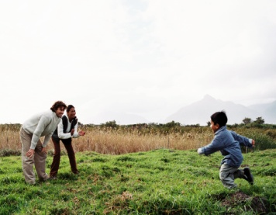
3
Unit 8 Section A
Reflections of a Chinese mother
in the West
FOREIGN LANGUAGE TEACHING AND RESEARCH PRESS
AIR FORCE ENGINEERING UNIVERSITY
Notes:
1

Slide 2
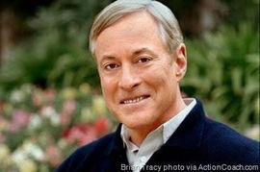

3
8
UNIT
If you raise your children to feel that they can accomplish any goal or task they decide upon, you will have succeeded as a parent and you will have given your children the greatest of all blessings.
— Brian Tracy (Canadian author)
A boy or girl who knows that love abounds at home will not resent well-deserved punishment. One who is unloved or ignored will hate any form of discipline.
— Dr. James Dobson (American author)
Notes:
2

Slide 3

^{Section A}
3
8
The art of parenting
UNIT
Reflections of a Chinese mother
in the West
To talk about different approaches to children’s education
Objectives
To further understand the text
To apply the phrases and patterns
To master the essay writing skill

Slide 4
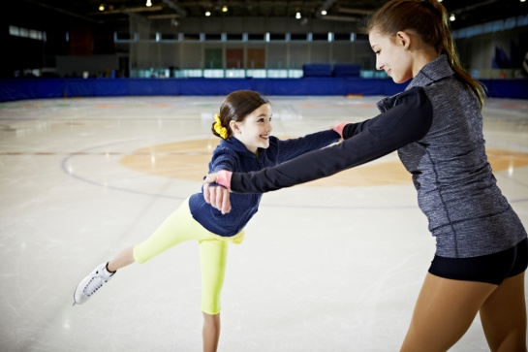





Section A
Reflections of a Chinese mother in the West
Contents
Warming-up activities
Text study
Language application
Summary

Slide 5
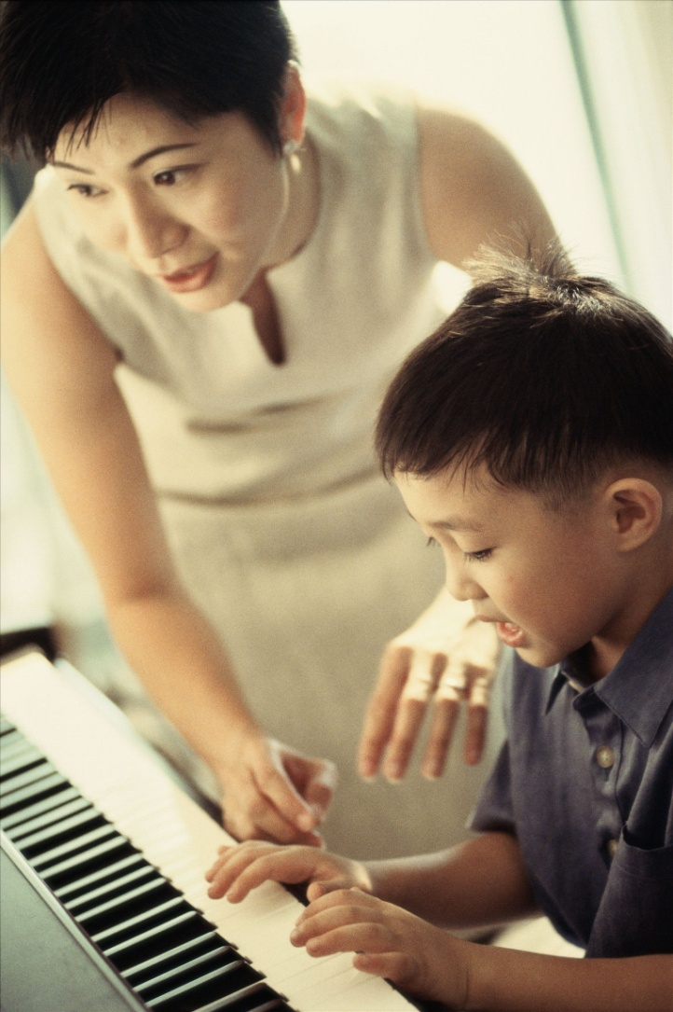


Section A
Reflections of a Chinese mother in the West
Warming-up activities
Lead-in
Pre-reading activities
Cultural background

Slide 6



Lead-in
Short answer questions
Watch a video clip and answer the two questions.
Q1: Is your mother a Tiger Mother? What would your parents do if you failed to meet their expectations?
Tips
Q2: Have you ever hated your parents when they forced you to do something you disliked but which later proved to be worthy of your efforts?
Tips
Video Watching

Slide 7
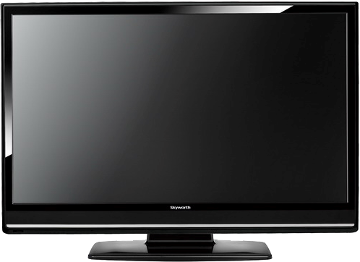
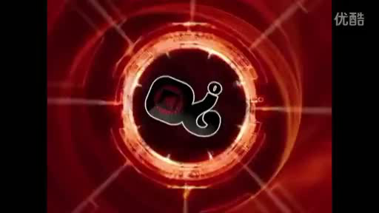
Lead-in
Short answer questions

Slide 8

Lead-in
Short answer questions
1. Is your mother a Tiger Mother? What would your parents do if you failed to meet their expectations?
Yes.
Assume strength rather than fragility;
Be strict with me;
Not permit me to do …;
Physically punish me.

Slide 9
Lead-in
Short answer questions
2. Have you ever hated your parents when they forced you to do something you disliked but which later proved to be worthy of your efforts?
Yes.
Force me to learn the Chinese calligraphy;
Physically punished me because of my lack of
self-discipline;
Be all for my good;
Better appreciate traditional culture;
Foster patience and persistence;
Be forever grateful for their guidance.

Slide 10
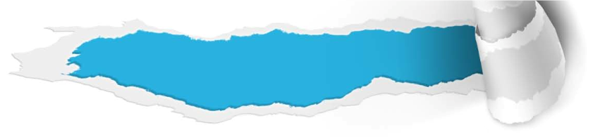


Pre-reading activities
Listen and talk
Listen to a short talk about an interesting
competition and then discuss the questions.
1. Why did the boy who had done nothing win all the prizes that day?
Tips
2. What do you think your parents expect most from you?
Tips

Slide 11
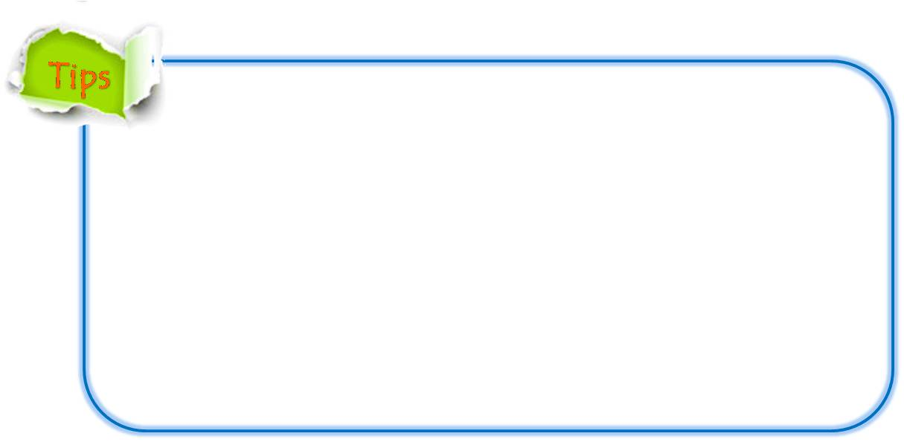
Pre-reading activities
Listen and talk
1. Why did the boy who had done nothing win all the prizes that day?
To obey his parents;
Obedience is the most important quality;
To feel extremely happy if parents have such an obedient kid.

Slide 12
Pre-reading activities
Listen and talk
2. What do you think your parents expect most from you?
To have a good education;
To land a satisfactory job to support myself;
To be honest and mature;
To be the best.

Slide 13

Pre-reading activities
Compound dictation
Listen to a short passage and fill in the missing information.
This is the VOA Special English Education Report.
Some American parents might think their children need better educations to ___________ with China and other countries. But how much do the parents themselves need to change?
compete
To be continued

Slide 14
Pre-reading activities
Compound dictation
Listen to a short passage and fill in the missing information.
A new book called Battle Hymn of the Tiger Mother by Amy Chua has caused a _________ about cultural differences in ____________. Ms. Chua is a professor at the Yale Law School in New Haven, Connecticut, and the mother of two daughters.
debate
parenting
To be continued

Slide 15
Pre-reading activities
Compound dictation
Listen to a short passage and fill in the missing information.
She was ________ in the American Midwest by ____________ Chinese parents. In the Chinese culture, the tiger represents ___________ and power. In her book, Ms. Chua writes about how she demanded excellence from her daughters.
raised
immigrant
strength
To be continued

Slide 16
Pre-reading activities
Compound dictation
Listen to a short passage and fill in the missing information.
For example, she ________________ burn her daughter's __________________ unless she played a piece of music perfectly. She would ________ her daughters if they failed to meet her ____________.
threatened to
stuffed animals
insult
expectations

Slide 17

Cultural background
Questions Previewing
What is the most popular grading system in the United States?
Tips
2. What is the core of Confucianism?
Tips
3. What can children do in the sleep-away camps?
Tips

Slide 18


Cultural background
What is the most popular grading system in the United States?
Discrete evaluation in the form of letter grades;
Follow a five-point system, using the letters A, B, C, D and F;
A indicating excellent, C indicating average and F indicating failing.

Slide 19
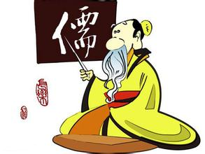
Cultural background
2. What is the core of Confucianism?
Humanism, the belief that human beings are teachable, improvable and perfectible through personal and communal endeavor especially including self-cultivation and self-creation.

Slide 20
Cultural background
3. What can children do in the sleep-away camps?
Sleep under the stars with friends;
Learn to shoot a bow and arrow;
Spend entire days in their swimming suits, etc.
There are all kinds of camps, and all offer opportunities for kids to engage in new skills while also immersing themselves in familiar pursuits.

Slide 21


Section A
Reflections of a Chinese mother in the West
Text study
Main idea & structure
Language focus
Critical thinking

Slide 22

Main idea & structure
Main ideas of the parts
This text is an argumentative essay. Western parents are ________________ Chinese parents’ success of raising kids. (Para.1)
baffled about
What do Westerners think of Chinese parents’ way of raising kids? (Para. 2)
Tips
provocative, unimaginable and even illegal

Slide 23
Main idea & structure
Main ideas of the parts
Differences between Chinese mothers and Western parents to an obese child (Para. 2):
Chinese mothers
Western parents
Tips
Tips
“Hey fatty, lose some weight.”
humane
tiptoe around the issue
never mention the f-word
Notes:
23

Slide 24

Main idea & structure
Main ideas of the parts
Part I — (Paras. 1- __)
2
Chinese parents raise successful kids, but they use some methods which are ________________________ to Westerners.
unacceptable (or different)

Slide 25
Main idea & structure
Main ideas of the parts
Part II — (Paras. 3-10)
It contains three sections and explains in detail what the three ideological differences are.

Slide 26
Main idea & structure
Main ideas of the parts
Why do Western parents want to protect their children from criticism? (Para. 3)
Tips
Children are tender and not strong;
Parents should protect their children’s self-esteem and protect children against the feeling of failure.
Notes:
26

Slide 27
Main idea & structure
Main ideas of the parts
The child comes home with a B (Paras. 4-5)
Western parents
Chinese parents
Tips
Tips
a screaming, hair-tearing explosion
praise the child
express disapproval
get practice tests
worry about their
child
use every tool to get her child’s grade up to an A
Notes:
27

Slide 28
Main idea & structure
Main ideas of the parts
Why do Chinese parents demand perfect grades?
(Para. 6)
Tips
Because they take it for granted that their child can get them, and grades are a more important measure of success than “self-esteem”.
Notes:
28

Slide 29
Main idea & structure
Main ideas of the parts
the second ideological difference
(Paras.7-8)
Chinese parents believe their kids ______ them everything. (Para. 7)
Most Westerners don’t believe their offspring must show permanent ____________ to their parents. (Para. 8)
owe
gratitude

Slide 30
Main idea & structure
Main ideas of the parts
the third ideological
difference
Para. 9
Third, Chinese parents believe they know what’s best for their children and therefore have ultimate _________________ their children’s desires and preferences. Chinese children have no rights to __________, which is why Chinese daughters can’t have boyfriends in high
authority over
infringe
To be continued

Slide 31
Main idea & structure
Main ideas of the parts
Para. 9
school and there are no late curfews or trips to sleep-away camps. Also even the slightest ___________ or _____________, anything less than unquestioning obedience, is extinguished, and punished into ______________.
defiance
indignation
submission

Slide 32
Main idea & structure
Main ideas of the parts
According to Western propaganda, what are Asian mothers like? (Para.10)
Tips
scheming
indifferent
militant
unconcerned with their kids’ true interests
Notes:
32

Slide 33
Main idea & structure
Main ideas of the parts
Which parenting method is more beneficial to
children’s success in the future, according to
the author? (Para.11)
Tips
Chinese parenting is more effective in equipping their children with skills, work habits and inner confidence for success in the future.
Notes:
33

Slide 34
Main idea & structure
Main ideas of the parts
Part III — (Para. 11)
The Chinese parenting method is more __________ and __________ because it can better prepare their children for the future.
practical
effective

Slide 35
Main idea & structure
Structure of the text
Introduction
Western parents are baffled by Chinese parents’ success
of raising kids. (Para. 1)
Chinese parents do things that seem provocative,
unimaginable, even illegal, to opinionated Westerners. (Para. 2)

Slide 36
Main idea & structure
Structure of the text
Introduction
Body
Chinese parents consider they know what’s best for their children and therefore have ultimate authority over their children’s desires and preferences.
(Paras. 9-10)
Western parents cradle
their children’s
self-esteem
to insulate them
from criticism. (Paras. 3-6)
Chinese parents believe their
kids owe them everything,
while Westerners don’t
think the offspring must show
permanent gratitude to the
parents. (Paras. 7-8)

Slide 37
Main idea & structure
Structure of the text
Introduction
Body
Conclusion
The Chinese parenting method is more
practical and effective because it can better
prepare their children for the future. (Para. 11)

Slide 38
Main idea & structure
Summary of the text
Reflections of a Chinese mother in the West
Western parents are _________ by Chinese parents’ success of raising kids. Chinese parents do things that seem provocative, unimaginable, even _________, to opinionated Westerners. There are three ideological differences between Chinese and Western parents.
baffled
illegal
To be continued

Slide 39
Main idea & structure
Summary of the text
First, Western parents cradle their children’s ____________ to insulate them from criticism. Chinese parents assume their kid is hardy enough to take the criticism. Second, Chinese parents believe their kids ______ them everything. Most Westerners don’t believe their offspring must show permanent ____________ to their parents.
self-esteem
owe
gratitude
To be continued

Slide 40
Main idea & structure
Summary of the text
Third, Chinese parents consider they know what’s best for their children and therefore have ultimate _____________ their children’s desires and preferences.
Of course there is also some _______
All decent parents want to do what’s best for their children. It’s the ____________ that’s different. The Chinese parenting method is more practical and _______ because it can better prepare their children for the future.
authority over
overlap
methodology
effective

Slide 41
Language focus
Practical phrases
Practical Phrases | Specific Meanings
1. dispense with | 摒弃；不用（做）
2. in terms of | 从…方面说来
3. insulate sb. / sth. from / against | 使免除（不愉快的经历）； 使免受
4. irrespective of | 不受某事物影响；不问某事物
5. have authority over | 具有对…的管辖权
6. have a high/low / good / bad opinion of sb. / sth. | 对（某人或某事）有（很高、很低、很好、很坏的）评价

Slide 42

Language focus
Practical phrases
摒弃；不用（做）
短语逆译
to dispense with
短语应用
年轻人应该学会节俭，摒弃一切不必要的奢侈品。
意群提示
(be thrifty / dispense with / luxuries)
Young people should learn to be thrifty, dispense with all unnecessary luxuries.

Slide 43
Language focus
Practical phrases
从…方面说来
短语逆译
in terms of
短语应用
对许多企业来说，对雇员开支账户的管理，不管是时间还是成本花费，都是令人棘手和头疼的问题。
意群提示
(expense accounts / an unwanted headache)
For many businesses the administration of employees’ expense accounts can be an unwanted headache, both in terms of time spent and cost.

Slide 44
Language focus
Practical phrases
使免除（不愉快的经历）；使免受
to insulate sb. / sth. from / against
短语逆译
短语应用
纵观世界，巨富之人的生活都是被重重保护起来的，不受周围贫苦民众苦难生活的影响。
意群提示
(be insulated from / the suffering lives)
All around the world, extremely wealthy people live a rather protected lifestyle and are insulated from the suffering lives of the poor all around them.

Slide 45
Language focus
Practical phrases
不受某事物影响；不问某事物
短语逆译
irrespective of
短语应用
不分种族、信仰或肤色，法律适用于所有的人。
意群提示
(apply to / irrespective of / creed)
The laws apply to everyone irrespective of race, creed or color.

Slide 46
Language focus
Practical phrases
具有对…的管辖权
短语逆译
to have authority over
短语应用
对成年人而言，他们有权管理自己的情绪和欲望。
意群提示
(have authority over / emotions and desires)
For adults, they have authority over their emotions and desires.

Slide 47
Language focus
Practical phrases
对（某人或某事）有（很高、很低、很好、很坏的）评价
to have a high / low / good / bad opinion of sb. / sth.
短语逆译
短语应用
许多英国人对这些政客们的评价很低，觉得他们没有奉献精神。
意群提示
(have a low opinion of / not dedicated)
Many British people had a low opinion of the politicians and felt that they were not dedicated.

Slide 48
Language focus
Functional patterns
Functional Patterns | Functions & Usages
1. The fact is that sb. do things that seem provocative…, even … to sb. | 用于表达“其他人对某人做 事情的看法”。
2. That’s why the solution to sth. is always to do sth. | 用于表示“对某人/事的应对措施”。
3. Another area where Chinese and Westerners clash is that most Westerners / Chinese believe sb. must / can do sth. | 用于表示“中西方理念的 差异”。
4. When the time comes to do sth., … | 用于表示“特定时刻的来临…”。
Notes:
48

Slide 49
Language focus
Functional patterns
原句译文
事实是，中国父母的做法，对固执己见的西方人来说，令人愤慨，难以想象，甚至是违法的。
逆译练习
The fact is that Chinese parents do things that seem provocative, unimaginable, even illegal, to opinionated Westerners. (Para. 2, L1)
句型提炼
Notes:
49

Slide 50
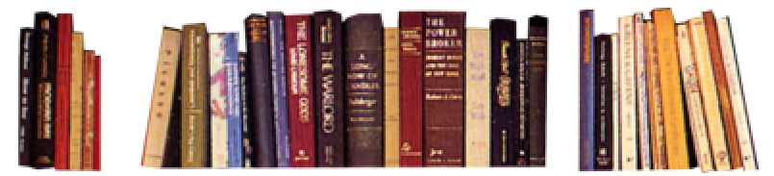
Language focus
Functional patterns
句型提炼
The fact is that sb. do things that seem provocative/unimaginable/sad…, even illegal, to sb.
应用提示
用于表达“其他人对某人做事情的看法”。
句型应用
Notes:
50

Slide 51
Language focus
Functional patterns
典型例句
事实是，职业医闹的做法，对辛劳的医生来说，令人愤慨，不够理智，甚至是违法的。
意群提示
(hired hospital violators / provocative / irrational)
The fact is that hired hospital violators do things that seem provocative, irrational, even illegal, to the hard-working physicians.

Slide 52
Language focus
Functional patterns
原句译文
这就是为什么对表现欠佳的孩子，父母总是会施以惩罚和辱骂。
逆译练习
That’s why the solution to substandard performance is always to punish and shame the child. (Para. 6, L4)
句型提炼
Notes:
52

Slide 53
Language focus
Functional patterns
句型提炼
That’s why the solution to sth. is always to do sth..
应用提示
用于表达“对某人/事的应对措施”。
句型应用
Notes:
53

Slide 54
Language focus
Functional patterns
典型例句
全球变暖的主要原因是人为污染。 这就是对于全球变暖问题的解决方法，人们总是要控制大气污染。
意群提示
(global warming / air pollution)
The main cause of global warming is man-made pollution. That is why the solution to the problem of global warming is always to control air pollution.

Slide 55
Language focus
Functional patterns
原句译文
中西方理念碰撞的另一领域是，西方人大多认为子女无须永远感激父母。
逆译练习
Another area where Chinese and Westerners clash is that most Westerners don’t believe offspring must show permanent gratitude to parents. (Para. 8, L1)
句型提炼
Notes:
55

Slide 56
Language focus
Functional patterns
句型提炼
Another area where Chinese and Westerners clash is that most Westerners / Chinese believe sb. must / can do sth.
应用提示
用于表达“中西方理念的差异”。
句型应用
Notes:
56

Slide 57
Language focus
Functional patterns
典型例句
中西方理念碰撞的另一领域是，中国人大多认为养儿防老。
意群提示
(raise children / provide against old age)
Another area where Chinese and Westerners clash is that most Chinese people think that they can provide against old age by raising children.

Slide 58
Language focus
Functional patterns
原句译文
到表现时机来临时，中国孩子已经成竹在胸。
逆译练习
When the time comes to perform, Chinese children have a blueprint for success.
句型提炼
Notes:
58

Slide 59
Language focus
Functional patterns
句型提炼
When the time comes to do sth., …
应用提示
用于表示“特定时刻的来临…”。
句型应用
Notes:
59

Slide 60
Language focus
Functional patterns
典型例句
到了该展示你那套独特的运动技能和身体天赋时，你有信心吗？
意群提示
(unique set of sporting skills / physical gifts)
When the time comes to demonstrate your unique set of sporting skills and physical gifts, do you have confidence?

Slide 61

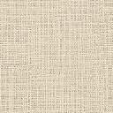
Language focus
Language appreciation
中国父母要求完美的成绩，因为他们理所当然地认为孩子完全可以做到，而且分数是比“自尊”更为重要的衡量成功的标准。
a. Chinese parents demand perfect grades because they take it for granted that their child can get them, and grades are a more important measure of success than “self-esteem”. (Para.6, L1)

Slide 62
Language focus
Language appreciation
中国父母如此磨砺子女为将来计，让其了解自己的所能，并赋予他们技能、工作习惯和内在信心这些没人能拿走的东西，这样来对孩子进行保护。
b. Chinese parents protect their children by armoring them for the future, letting them see what they’re capable of, and conferring upon them skills, work habits, and inner confidence that no one can ever take away. (Para.11, L4)

Slide 63
Language focus
Language appreciation
到表现时机来临时，中国孩子已经成竹在胸；他们知道该如何利用自己在这个世界上所能学到的最好的本事去竞争。“布丁”好坏，一试便知！
c. When the time comes to perform, Chinese children have a blueprint for success; they know how to compete with the best the world has to offer. The proof is in the pudding! (Para.11, L7)

Slide 64

Critical thinking
Theme exploration
1 What kind of parenting method do you prefer, from the standpoint of a child?
Tips
To what extent do you think Confucius’ education philosophy affects traditional Chinese parenting methodology?
Tips

Slide 65

Critical thinking
Theme exploration
What kind of parenting method do you prefer, from the standpoint of a child?
• I prefer Western parents’ parenting method. Western parents provide enough space for their children’s development so that they can grow happily and become healthy, creative, open-minded, and independent. What parents should do is to teach their children based on their own characteristics.
• I like Chinese parents’ parenting method. Chinese parents seem to be too strict with their kids, but their method proves to be more practical and effective than the one adopted by Western parents. Children brought up by Chinese parents obviously are more likely to succeed in their study and career.

Slide 66
Critical thinking
Theme exploration
2. To what extent do you think Confucius’ education philosophy affects traditional Chinese parenting methodology?
On the other hand, there are also some positive aspects inherited from Confucian culture. For example, it encourages knowledge and spiritual growth. It also encourages politeness, respect and kindness, preaching humaneness toward others.
In Confucian culture, children have to accept all advice and demands from parents without questioning. Parents are authoritative and require obedience and submissiveness from their children. Children are shown how to behave and are expected to follow suit. Therefore, children develop a habit of passively accepting knowledge, and a tendency to view things uncritically and to avoid exploration.

Slide 67

Critical thinking
Watching and discussing
Watch a video clip and discuss the following question.
Which teaching method is better, Chinese parenting or western parenting?
Tips
Video Watching

Slide 68

Critical thinking
Watching and discussing
Back

Slide 69

Critical thinking
Watching and discussing
Which teaching method is better, Chinese parenting or western parenting?
Chinese patenting
Western parenting
Tips
Tips
obedience and
discipline;
focus on children’s
IQ development;
perfect grades;
land a satisfactory job.
freedom;
a happy childhood;
more encouragement;
a relaxed environment;
mental health.

Slide 70

Section A
Reflections of a Chinese mother in the West
Language application
Writing devices
Essay writing
Paragraph translation

Slide 71
Writing devices
Develop an argumentative essay
When we write an argumentative essay, our main purpose is to convince the readers that our particular view or opinion on a controversial issue is correct. At times, we may have a second purpose for our argumentative essay: to persuade our readers to take some sort of action.
In a general way and as with all essays, we do the same thing: We make a point and then support it. The difference is that argumentation advances a controversial point, a point that at least some of the readers will not be inclined to accept. Here is an example from Text A:
to be continued

Slide 72
Writing devices
Western parents cradle their children’s self-esteem, which is different from Chinese parents. (Para. 3)
How Western parents react to the score of their child
on a test. (Para. 4)
How Chinese parents react to the score of their child
on a test. (Para. 5)
The author justifies Chinese parents’ behavior. (Para. 6)
to be continued

Slide 73
Writing devices
Develop an argumentative essay
To convince readers in an argumentative essay, it is important to provide them with a clear main point and plenty of logical evidence to back it up. Because argumentation assumes controversy, we have to work especially hard to convince the readers of the validity of our position.
to be continued

Slide 74
Writing devices
Develop an argumentative essay
The following five strategies may help us win over readers whose viewpoints may differ from ours.
1 Use tactful, courteous language.
2 Point out common ground.
3 Acknowledge differing viewpoints.
4 When appropriate, grant the merits of
differing viewpoints.
5 Rebut differing viewpoints.

Slide 75

Essay writing
Read the sample essay and see how the argumentation is developed.

Slide 76
Essay writing
Topic:
Why should you eat breakfast?
Introduction:
Thesis statement: Eating breakfast is very
important, especially for students.
to be continued

Slide 77
Essay writing
Body:
Argument 1: You should eat breakfast for your
health before going to school.
Argument 2: You need food to be in a better
mood.
Argument 3: You need food to do well in your
classes.
to be continued

Slide 78
Essay writing
Conclusion:
Breakfast is the most important meal of the day.
to be continued

Slide 79
Essay writing
Sample:
A lot of people, especially young people, go through the day without having breakfast. Many people believe that it is not necessary, or they say that they don’t have time for that, and begin their day with no meal at all. I believe that everyone should eat breakfast before going to their activities. Have breakfast is extremely important, especially for students who need energy to survive heavy schoolwork.
to be continued

Slide 80
Essay writing
Sample:
The first reason why you should eat breakfast before going to school is for your health. When you skip breakfast and go to school, you are looking for a disease because it’s not healthy to have an empty stomach. Breakfast provides you with the energy source you need to face the day. If you don’t eat breakfast, your body is weakened and you are likely to get sick, and any type of disease will have a stronger effect on you than on people who have breakfast every day.
to be continued

Slide 81
Essay writing
Sample:
Another reason for eating breakfast is that it can put you in a better mood. Studies show that people who eat breakfast tend to be in good moods, and those who don’t eat breakfast are more easily to be tired and irritable, so eating breakfast can make you happier as it can improve your mood and reduce stress levels. Breakfast gets you started on the right track for the day.
to be continued

Slide 82
Essay writing
Sample:
The last reason to have breakfast every day is that you need food to do well in your classes. Your body and your brain are not going to function as well as they could because you have no energy and no strength. When you try to learn something with nothing in your stomach, you are going to have a lot of trouble succeeding. Many people think that they should not eat because they are going to feel tired, but that’s not true. Breakfast is not
to be continued

Slide 83
Essay writing
Sample:
a very big meal, and on the contrary, you’re going to feel tired if you don’t have breakfast because you have spent the entire previous night without food.
You have to realize that breakfast is the most important meal of the day, and you cannot skip it without consequences for your health, your mood and your academic performance. It is better to wake up earlier and have a good breakfast than to run to school without eating anything. It is time for you to do something, and eating breakfast is the best way to start your day.

Slide 84

Essay writing
Writing practice
Directions: Write an essay of no less than 200 words on one of the following topics. One topic has an outline that you can follow.

Slide 85
Essay writing
Topic: Drunk drivers should be imprisoned on their first offense.
Introduction: Thesis statement: Drivers convicted of drunk driving
should be imprisoned on their first offense.
Body:
Argument 1: Imprisoning drunk drivers on their first offense can save lives of innocent people.
Argument 2: Imprisoning drunk drivers on their first offense can prevent drunk drivers from committing the crime again.
Argument 3: Imprisoning drunk drivers on their first offense will discourage other people from drunk driving.
Conclusion: Drunk driving is completely preventable if drunk
drivers are harshly punished.

Slide 86
Essay writing
You may adopt the following expressions.
According to the statistics;
As shown in a study;
To imprison drunk drivers on … ;
To result in road accidents, injuries and deaths;
Therefore, to save more innocent people from …;
To be a big shock for those who are likely to do …;
Drunk driving is a serious crime but …

Slide 87
Essay writing
More topics:
• Should girls ask boys out?
• Should animals be used for
research?

Slide 88
Paragraph translation
Translate a paragraph based on a summary of the text by using the expressions from the text.

Slide 89
Paragraph translation
很多西方父母想知道，为什么中国父母能养育出那么多天分极佳的孩子。事实是，中国父母的做法，对固执己见的西方人来说，令人愤慨，难以想象，甚至是违法的。中西方的父母之间存在三种意识形态上的差异。
baffle
opinionated
provocative
ideological
To be continued

Slide 90
Paragraph translation
self-esteem
首先，西方父母呵护子女的自尊，使他们免受一切批评。其次，中国父母认为孩子亏欠他们一切。第三，中国父母相信他们知道什么最适合自己的孩子，因此对子女的愿望和喜好有着至高无上的权威。事实上，普天下称职的父母都想为孩子做最好的安排，只是方式方法不同而已。
owe
ultimate authority over
Samples

Slide 91
Paragraph translation
A lot of Western parents are baffled that Chinese parents produce so many children with an abundance of talent. The fact is that Chinese parents do things that seem provocative, unimaginable, even illegal, to opinionated Westerners. There are three ideological differences between Chinese and Western parents. First, Western parents cradle their children’s self-esteem to insulate them from criticism. Second, Chinese parents believe their kids owe them everything. Third, Chinese parents believe they know what’s best for their children and therefore have ultimate authority over their children’s desires and preferences. In fact, all decent parents want to do what’s best for their children. It’s the methodology that’s different.

Slide 92

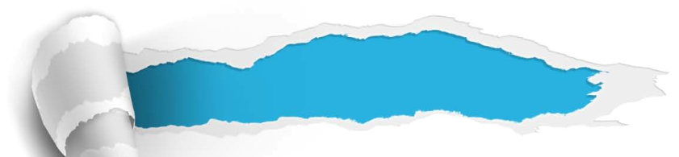

Section A
Reflections of a Chinese mother in the West
Summary
Revision of
the useful expressions
Thematic study
Revision of
the functional patterns

Slide 93
Revision of
the useful expressions
Language points—Useful expressions
1 固执己见的西方人
2 摒弃；不用（做）
3 贪婪地吃；狼吞虎咽
4 避而不谈
5 就…而言； 从…方面说来
6 逃避，躲过
7 使免除；使免受
8 不受某事物影响； 不考虑某事物
opinionated Westerners
dispense with
gorge (oneself) on sth.
tiptoe around sth.
in terms of
get away with sth.
insulate sb. / sth. from / against
irrespective of

Slide 94
Revision of
the useful expressions
Language points—Useful expressions
9 由某人支配；供某人使用
10 自尊
11 儒家“忠”的信条
12 把…强加于…
13 具有对…的管辖权
14 曲解某人
15 就…而言
16布丁好不好，吃了才知道
at one’s disposal
self-esteem
Confucian doctrine of loyalty
force sth. on / upon sb.
have authority over
get sb. wrong
for one’s part
the proof is in the pudding

Slide 95
Revision of
the functional patterns
Language points—Useful patterns
Functions & Usages | Sentence Patterns
1. 用于表达“其他人对某人做事情的看法”。
2. 用于表示“对某人/事的应对措施”。
3. 用于表示“中西方理念的差异”。
4. 用于表示“特定时刻的来临…”。
The fact is that sb. do things
that seem …, even … to sb.
That’s why the solution to sth. is always to do sth.
Another area where Chinese and Westerners clash is that ...
When the time comes to
do sth., …
Notes:
上面挤，下面空

Slide 96



Section A
Reflections of a Chinese mother in the West
The end

